Slide 1
LLMs for Automation
Overview
This lesson focuses on using Large Language Models (LLMs) and how they can be used for automation. It aims to provide students with an understanding of how these models work and how they can be applied in various automation tasks.
Learning Objectives
Identify the key steps involved in designing an automation.
Explain the different types of automation LLMs can assist with.
Apply the principles of automation design to a real-world business process.

Slide 2
Suggested Agenda (45 min)
0:00-0:02 Review Learning Objectives
0:02-0:20 Using LLMs for Automation
0:20-0:30 Practice: Create a Reusable Prompt
0:30-0:40 Practice: Generating Code with ChatGPT
0:40-0:45 Reflection
*these are estimates - timings will vary!

Slide 3
Teaching Guide:
Use the following quick tips for instructional guidance.
Title | What to Do
Learning Objective Slides | Pause to unpack the learning objectives and prime students for the lesson. This is a crucial step in the learning process and gives participants time to build context and activate any prior knowledge.
Solo Activities | For solo activities, you can choose to put people in group breakout rooms (to create the “table” group that they would be in in a physical setting) or allow students to work independently in the main session.
Group and Partner Discussions and Exercises (Remote) | Creating Breakout Rooms — Group and Partner Exercises Set up breakout rooms for pairs/groups. Broadcast directions and discussion questions to all breakout rooms. At the 60-seconds-left mark, broadcast a message to all rooms: “Start to wrap up your discussions. Rooms will close in one minute!” Move around from breakout room to breakout room to “walk around the classroom.”
Group and Partner Discussions and Exercises (In Person) | Facilitating Group and Partner Discussions and Exercises — Live Classroom Arrange the room prior to the session to create a conducive environment for group work. Provide clear, concise instructions verbally and on a handout or slide for the exercise, ensuring that all participants are aware of the goals and the time allocated. Circulate around the room to engage with groups Display a timer or announce when there is 1 min remaining Facilitate the sharing of group conclusions or discussion points with the whole class, ensuring that each group has a voice.

Slide 4
LLMs for Automation

Slide 5
Identify the key steps involved in designing an automation.
Explain the different types of automation LLMs can assist with.
Apply the principles of automation design to a real-world business process.

Slide 6
Using LLMs for Automation

Slide 7
Frontline clinicians spend an hour doing an assessment with somebody and then they spend anything from one to two hours entering data about the consultation, and it’s unacceptable.
Dr Geraldine Strathdee, National Clinical Director for Mental Health
Notes:
All of our jobs are bundles of tasks - and some of those tasks provide huge value.
Take the example of healthcare professionals - they (hopefully) deliver immense value to both individuals and society.
But a common problem in healthcare is that the tasks that HCPs are good at get crowded out by busywork.
Entering data, filling out forms, creating a paper trail that often ends up not leading to positive outcomes.
This is where automation comes in.

Slide 8
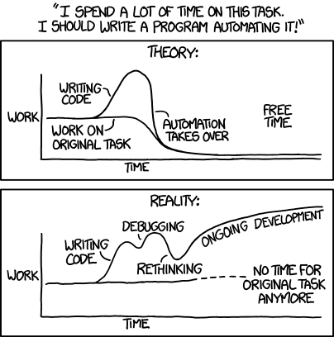
Source: xkcd: Automation
Notes:
But there’s been a problem up until now - often the time we would need to automate the busy work would end up taking up so much time we wouldn’t have the resources to complete important and urgent work.
—
The cartoon humorously contrasts the idealized expectation of automating a task with the reality that often ensues. It shows that while automation might be intended to save time, it can sometimes result in additional unforeseen work.
PURPOSE:
To highlight the potential pitfalls and misconceptions of automating tasks without proper planning or understanding.
TALKING POINTS
• The top graph represents the optimistic belief that automating a task will lead to a lot of free time.
• The bottom graph illustrates the challenges and additional work that can arise from attempting to automate without thorough consideration.
• Despite the intention to free up time with automation, one can end up spending even more time on the automation itself.
TEACHING TIPS
• Encourage students to think critically about when automation is truly beneficial and when it might introduce more complications.
• Discuss real-life examples where automation saved time and where it created additional challenges.
• Emphasize the importance of thorough planning and testing before fully committing to an automation solution.

Slide 9

Step by Step: Designing Automation
Step 1: Identify Repetitive and Time-Consuming Tasks
Step 2: Determine the Value and Feasibility of Automating Tasks
Step 3: Prioritize Task for Automation
Step 4: Choose the Right Automation Tool
Step 5: Reassign the task, if necessary
Step 6: Develop an Implementation Plan
…then loop back to step four as necessary.
Source: Dall-E 3
Notes:
Step 1: Identify Repetitive and Time-Consuming Tasks
Document Processes: Document your daily, weekly, and monthly tasks. This makes it easier to spot patterns and repetitive tasks.
Time Tracking: Implement a time-tracking tool to determine how much time is being devoted to specific tasks.
Feedback: Talk with your team to find out which tasks they consider tedious, repetitive, or overly time-consuming.
Step 2: Determine the Value and Feasibility of Automating Tasks
Cost-Benefit Analysis: Consider the time and resources required to automate a task against the time and cost saved once it is automated.
Impact on Work Quality: Determine if automation will enhance accuracy and consistency.
Scalability: Identify if the task occurs with enough frequency and volume to warrant automation.
Step 3: Prioritize Tasks for Automation
Quick Wins: Look for tasks that are easy to automate and would free up significant amounts of time.
High-Value Tasks: Prioritize automating tasks that, while potentially more complex, could generate considerable value in terms of savings or revenue
Risk Assessment: Consider the risks associated with automating each task, such as data security or customer satisfaction, and prioritize accordingly.
Step 4: Choose the Right Automation Tool
Research: Investigate the various automation tools available that suit the task requirements.
Compatibility: Ensure that the automation tool integrates well with your existing systems.
Scalability: Choose a solution that can grow with your business.
Step 5: Develop an Implementation Plan
Set Clear Goals: Define what success looks like by setting specific, measurable goals.
Create a Timeline: Develop a realistic timeline for implementation, including phases if necessary.

Slide 10
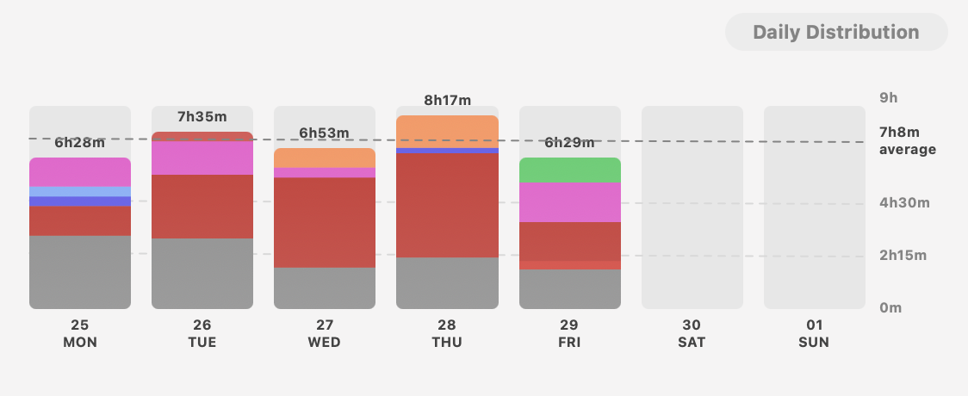
Identify Tasks to Automate
10 Minutes
BREAKOUT ROOM
Discuss daily, weekly, monthly tasks. Which are valuable? Which are not?
Time Tracking: do you have a time-tracking tool? Time-sheets? Screen-time? A calendar tool? How can you work out how much time is being devoted to specific tasks?
Share: which tasks does everyone consider tedious, repetitive, or overly time-consuming?
Choose: one common task to automate.
Notes:
PURPOSE: One sentence about why this slide is included/how it gets us closer to our learning goals.
TALKING POINTS
This is a suggested talking point for instructors.
Bullets are better than paragraph-y scripts.
TEACHING TIPS
Have a suggestion for what an instructor should do while teaching to this slide? Put it here!
This is an optional section. Not all slides require facilitation tips.

Slide 11
Example Tasks
Data Entry
Scheduling
Team onboarding
Generating Reports
Responding to basic customer inquiries.
Order Processing
Time-Tracking
Resume Screening

Slide 12
How Can We Use LLMs for Automation?
💬 Create Reusable LLM Prompts
To tackle repetitive tasks in the chat interface.
🦾 Build LLM into Automation Tools
Using No-code Tools.
👩🏽‍💻 Use LLMs to Generate Code
To tackle repetitive tasks on device or in the Cloud.
🗄️ Create LLM-powered Business Apps
Created by internal developers.
Notes:
A fifth option is that we use third party tools, “thin-wrappers”.
But we’re going to focus mostly on the examples you yourself can manage as an individual.

Slide 13
Let’s Focus on the First 3:
💬 Create Reusable LLM Prompts
To tackle repetitive tasks in the chat interface.
🦾 Build LLM into Automation Tools
Using No-code Tools.
👩🏽‍💻 Use LLMs to Generate Code
To tackle repetitive tasks on device or in the Cloud.
🗄️ Create LLM-powered Business Apps
Created by internal developers.

Slide 14
Create a Reusable Prompt

Slide 15
Create a Reusable Prompt
Task Example:
10 Minutes
Either choose the task you decided to automate from the breakout room, or the the task to the right.
Instructions:
Every month the client sends our team a list of meetings they need to attend as a screenshot in Slack.
Despite multiple requests, they continue to send it as a screenshot. For now, we want to automate the process of putting those meetings in our diaries.
1
Experiment to create a starting prompt that works really well for the task you want to automate.
2
Create the opening prompt as a sharable link that you can keep in a spreadsheet or document. Ensure that teammates can also use it.
3
Share the link to your task to the group chat for others to save (and reuse) in their spreadsheet
Notes:
SOLO ACTIVITY
Go through the instructions - provide a quick demo if students are confused.
Students complete activity. Monitor their progress and answer questions throughout.
Debrief after the activity:
In the process of creating your reusable prompt, what criteria did you use to determine its effectiveness for the task automation?
How did you ensure that your prompt was user-friendly and accessible for your teammates to implement in their workflow?

Slide 16
Get ChatGPT to Generate Code

Slide 17
IMPORTANT‼️
You should try out Google App Scripts yourself in preparation for the practice activity.
It is also a good idea to show participants a quick demo before they start so they have some context for the activity.

Slide 18
Generate Code for Automation
Other Examples:
10 Minutes
You very likely to use one of PowerPoint, Apple Keynote, or Google Slides, each of which has its own scripting tool - Microsoft VBA, AppleScript, Google Apps Script.
Instructions:
Change the font on all slides
Consolidate Multiple Presentations into One
Save outline to Word/Pages/Docs
Batch Image Insertion
Update Slide Footer with current year
Create Agenda or Table of Contents
1
Choose a task: remove all speaker notes, delete every third slide, or something else.
2
Refine until the code is ready. Copy-paste it into the relevant tool, and run the script.
3
Iterate until you are happy with your code, then feel free to share the code into the chat for others to use.
Notes:
Note: Encourage participants to use Google App Scripts since everyone will have a google account to work with.
SOLO ACTIVITY
Go through the instructions - provide a quick demo if students are confused.
Students complete activity. Monitor their progress and answer questions throughout.
Debrief after the activity:
What challenges did you encounter when refining your automation code, and how did you overcome them?
Can you describe how the automation code you've created has improved the efficiency or quality of your presentation preparation process?

Slide 19
LLMs for Automation

Slide 20
Reflection: LLMs for Automation
1
What other reusable prompts could you create for repetitive tasks?
2
Are you keen on using scripts for other tools? Documents? Spreadsheets? Calendar? Mail?
3
Next week, how can you better track how much time you’re spending on certain tasks?
4
How will you ensure that you don’t spend longer designing automations than time saved?

